Slide 1


Career Development and Employer of Choice
Recommendations

Slide 2
1
Motivation
Agenda
2
Actionable Scores to Stakeholders
3
Recommendations

Slide 3
Motivation
$
51%
Career Development
&
Employer of Choice
30
Acquisitions
of YoY increased expenditure is personnel cost, $1022 M
$70M
Talent Scarcity
Attrition Rate
>
Comfortable Levels
*
Major pain point
75%
**
Brand reputation
* Life sciences sector must prioritize talent experience and tech skills development to overcome talent shortage
**The Ultimate List of Employer Brand Statistics, LinkedIn Talent Solutions

Slide 4




Actionable Scores to Stakeholders
Program Effectiveness Score
Skill Readiness Index
Stakeholder : Chief Human Resource Officer(CHRO), Talent Manager
Stakeholder : Hiring Manager
Candidate Alignment Score
Organization Health Score
Stakeholder : Talent Manager
Stakeholder : Chief Human Resource Officer(CHRO)

Slide 5
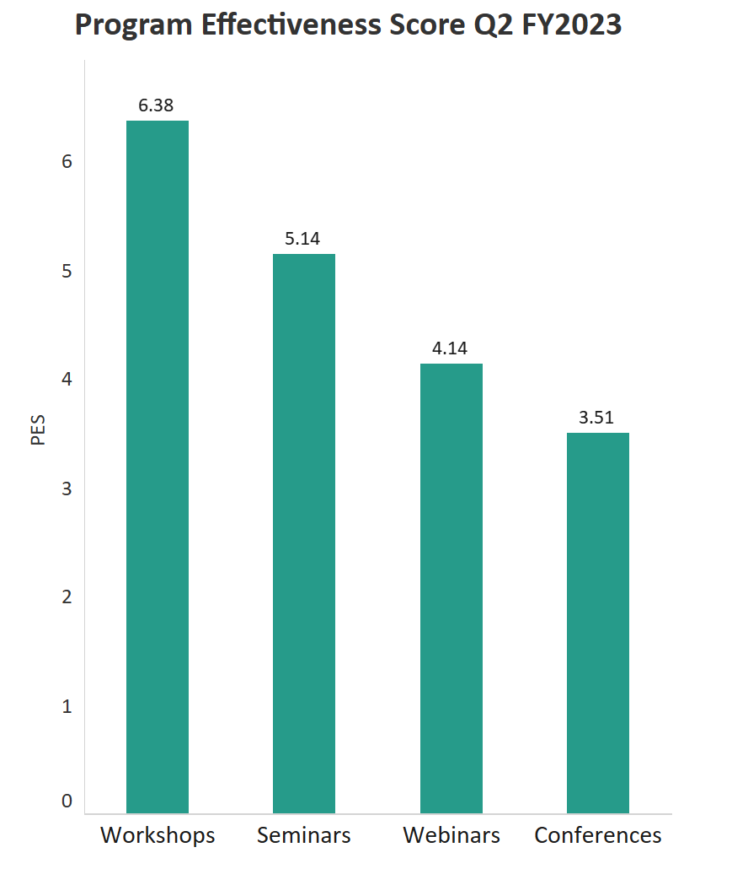
Program Effectiveness Score
Utility
Determine the career development methods with highest return on investments
Budget , Human effort allocation
Recommendations
Allocate 50% of budget to workshops, 30% to seminars and distribute the remaining 10% equally between webinars and conferences.
Benefits
Assist the Chief Human Resource Officer in selecting cost-effective programs that will yield a higher ROI.
PES = (0.2 * %change in performance + 0.2 * %change in skills + 0.2 * %change in error rate) + 0.4 * (Total Cost / No of employees attended)
The data used for the graphs is for illustration purpose only and is assumed

Slide 6
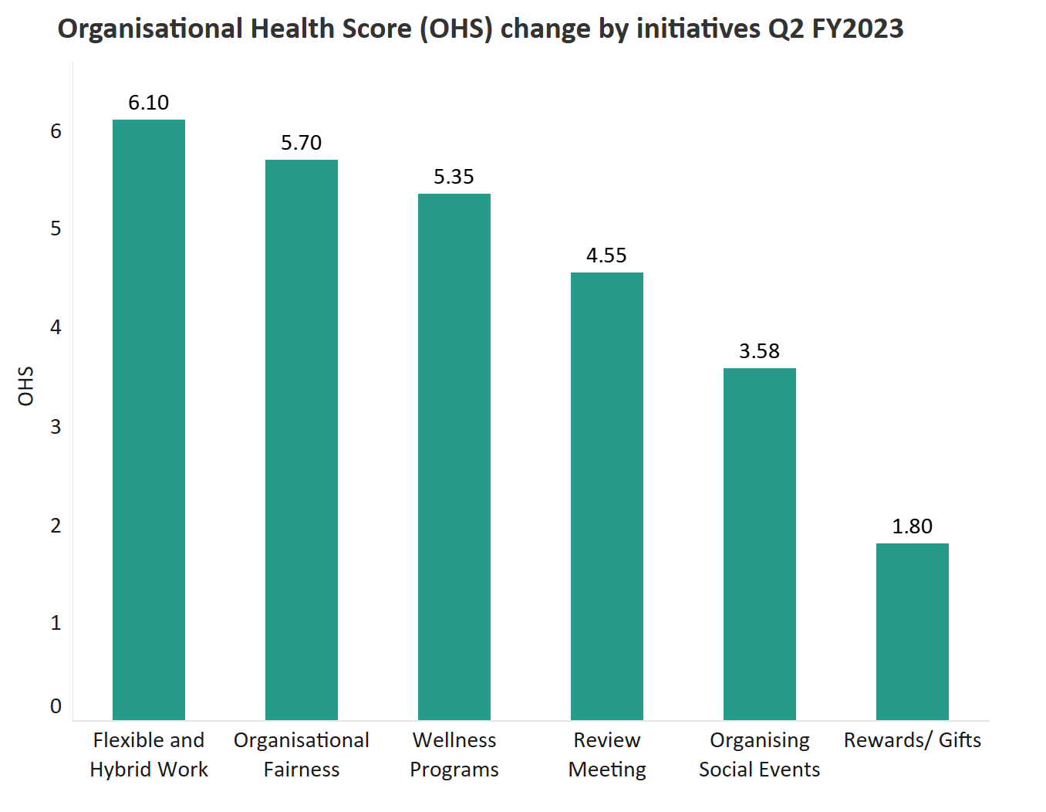
Organization Health Score
Utility
Organisation Performance Indicator
Budget allocation
Strategy prioritization
23%
21%
20%
Recommendations
Prioritise Flexible and Hybrid Work, Organisational Fairness and Wellness Program strategies.
Allocate 23%, 21% and 20% to 1,2,3 respectively and distribute the remaining 36% equally between 4,5,6
1
Benefits
Reduce attrition, enhance reputation and job satisfaction
2
3
4
5
6
OHS= (0.2* % change in Organisational Reputation) + (0.2* % change in Job satisfaction rate) - (0.3* Total Investment) - (0.3*% change in Attrition rate)
The data used for the graphs is for illustration purpose only and is assumed

Slide 7
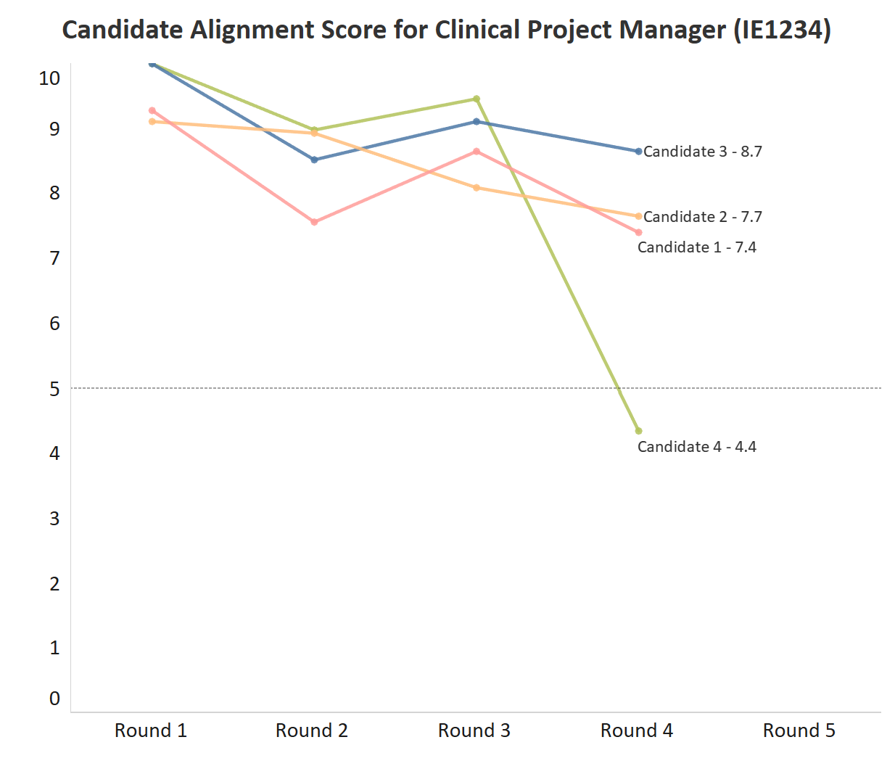
Candidate Alignment Score
Utility
Candidate selection
Recommendations
Eliminate Candidate 4.
Candidate 1,2 and 3 proceed to Round 5.
Threshold
1
2
3
4
5
6
CAS = (0.2 * (Current skills/Required skills)) – (0.2 * (Expected compensation – Allocated budget)) + (0.4 * Interview performance score) + (0.1 * Relevant years of work experience) – (0.05 * Interview cost) + (0.05 * Perceived reputation of the company)
The data used for the graphs is for illustration purpose only and is assumed

Slide 8
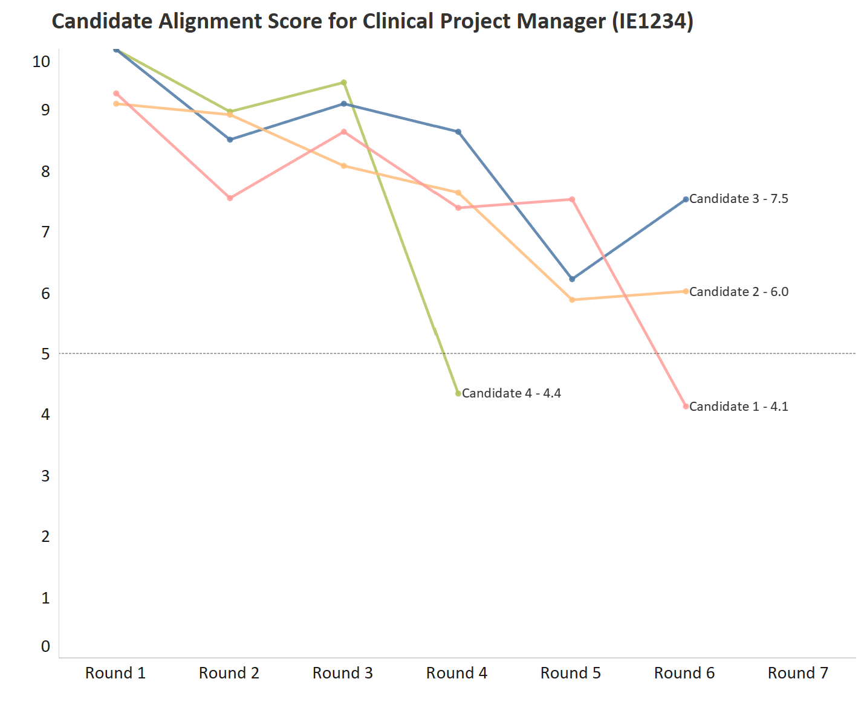
Candidate Alignment Score
Recommendations
Eliminate Candidate 1.
Candidate 2 and 3 advance to the 7th Round.
Threshold
Benefits
Cost of interview savings
Minimise time and human effort
CAS = (0.2 * (Current skills/Required skills)) – (0.2 * (Expected compensation – Allocated budget)) + (0.4 * Interview performance score) + (0.1 * Relevant years of work experience) – (0.05 * Interview cost) + (0.05 * Perceived reputation of the company)
The data used for the graphs is for illustration purpose only and is assumed

Slide 9
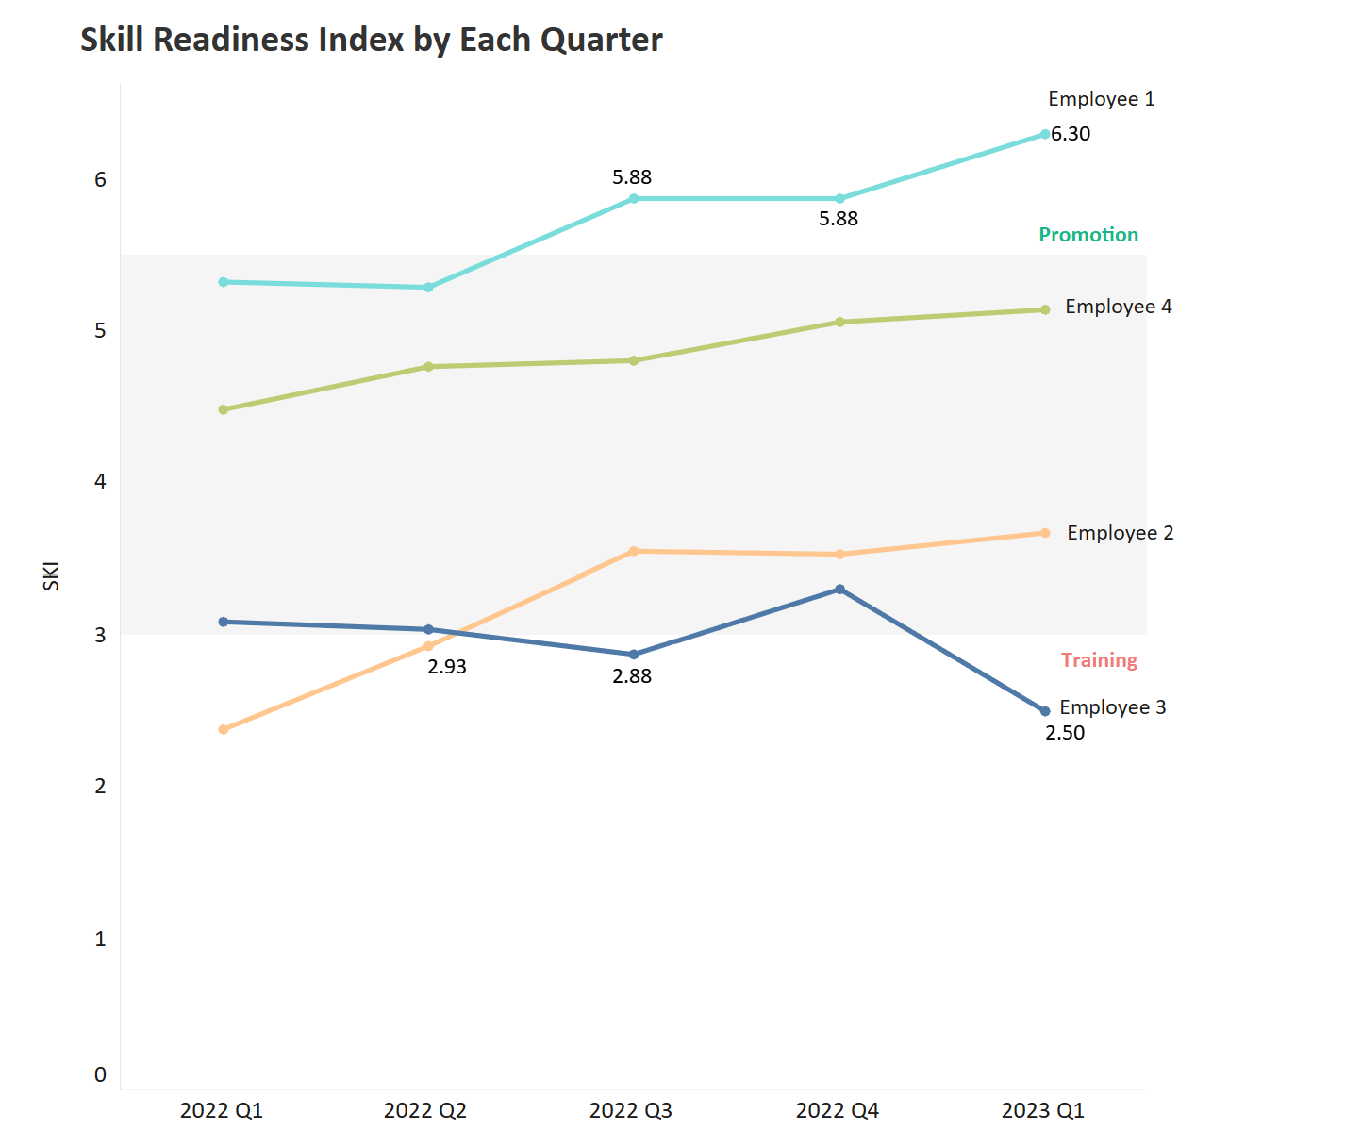
Skill Readiness Index
Utility
Identify skills to be acquired
Suggest certifications to pursue
Enhance employee recognition, rewards and responsibility
Recommendations
Employee 3 requires skill enhancement.
Recommend promoting Employee 1.
1
2
3
4
5
6
The data used for the graphs is for illustration purpose only and is assumed

Slide 10
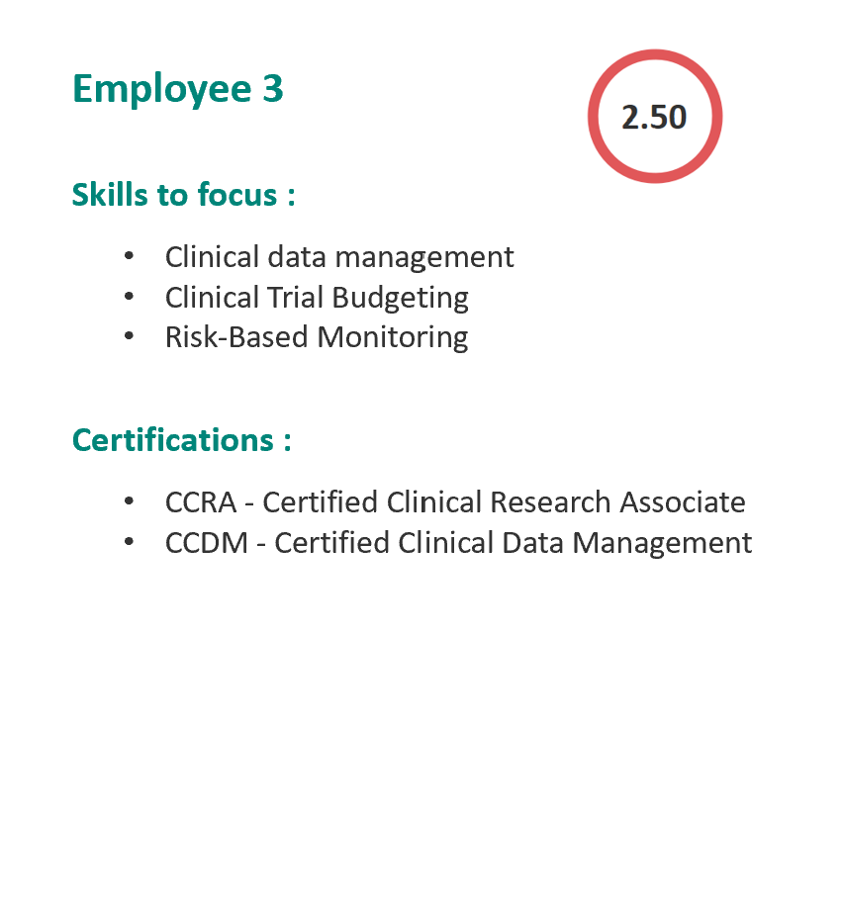
Skill Readiness Index
Recommendations
Employee 3 requires skill enhancement
Mentoring / Counselling session
Benefits
Precision upskilling
Continuous learning
Targeted budget allocation
Chart skill driven career path
1
2
3
4
5
6
The data used for the graphs is for illustration purpose only and is assumed

Slide 11
THANK YOU

